Slide 1
Android Development
Android Studio, Activities & Fragments

Slide 2
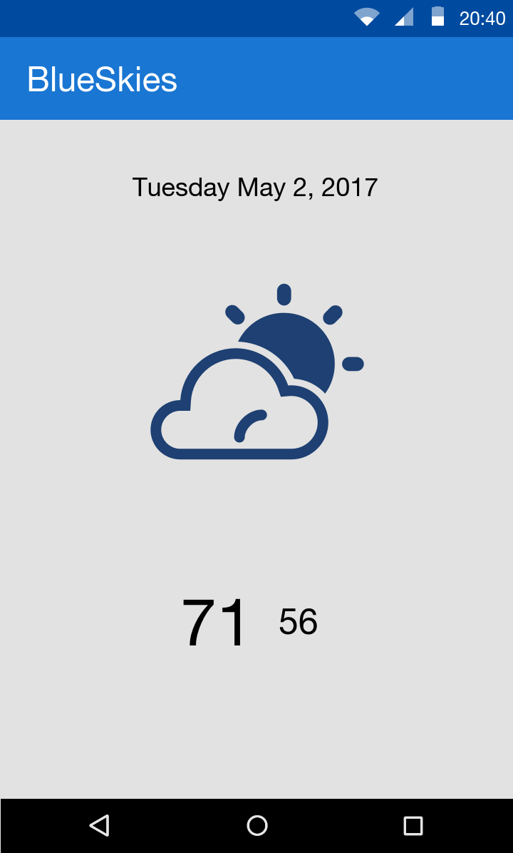
Goals
Develop a BlueSkies App

Slide 3
Agenda
High Level
Android Studio
Overview
Activity
Responsibility
Caveats
Fragment
Responsibility
Caveats

Slide 4
Agenda (cont)
Detail Level
Activity
Lifecycle
Coding Activity
XML layout
Manifest.xml
Activity to Activity communication

Slide 5
Agenda (cont)
Fragment
Lifecycle
Coding Fragment
XML Layout
Fragment to Activity communication
Activity to Fragment communication
Attaching Fragment to Activity

Slide 6
High Level

Slide 7
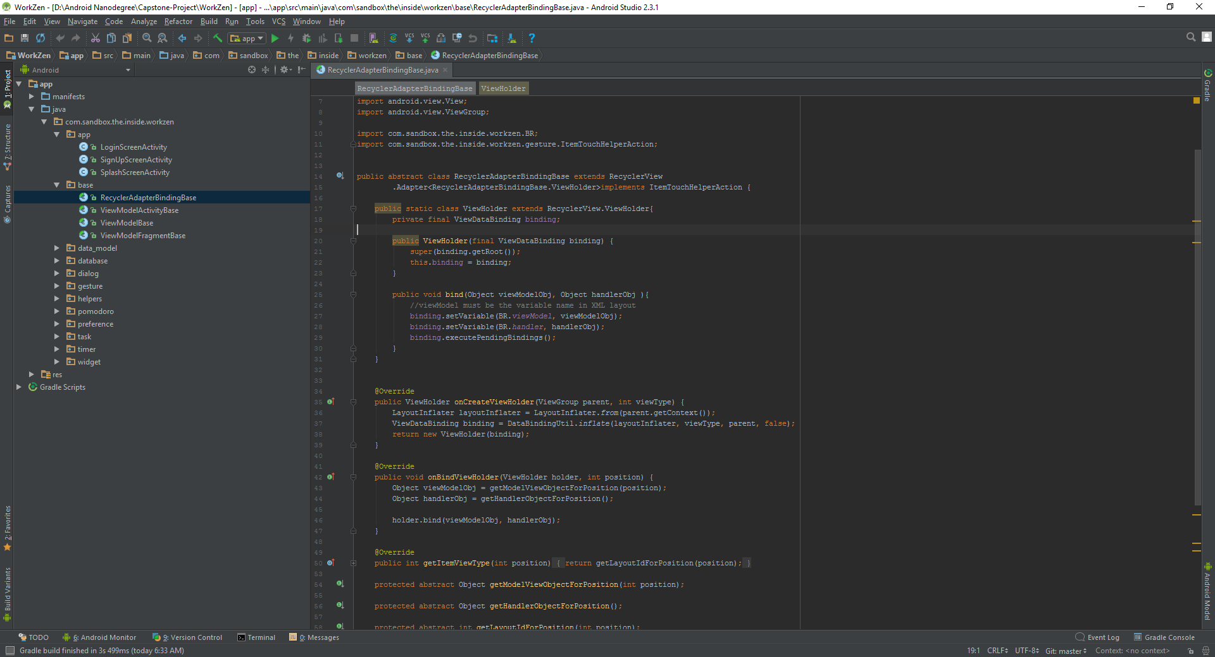
Android Studio
De facto standard for Android development
Built on the IntelliJ
Some features
Layout Editor
Built in emulator
Gradle integration
Instant Run (Hot swap)
https://developer.android.com/studio/index.html

Slide 8
Definition Overview
Activity
Fragments
Views
Manifest

Slide 9

Activity https://developer.android.com/guide/components/activities/index.html
Fundamental building blocks
Entry point for user's interaction
Provides navigates within an app
Communication between other activities
Communication between child fragments
No Creation or Modification of Views

Slide 10

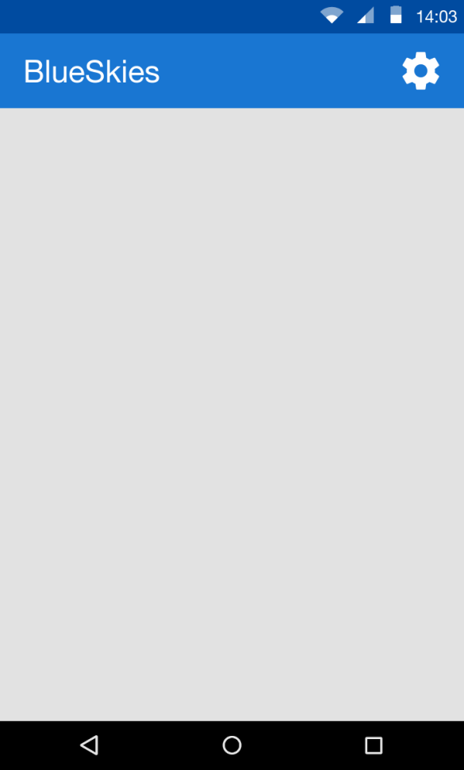
Think of an Activity as a picture frame
=

Slide 11
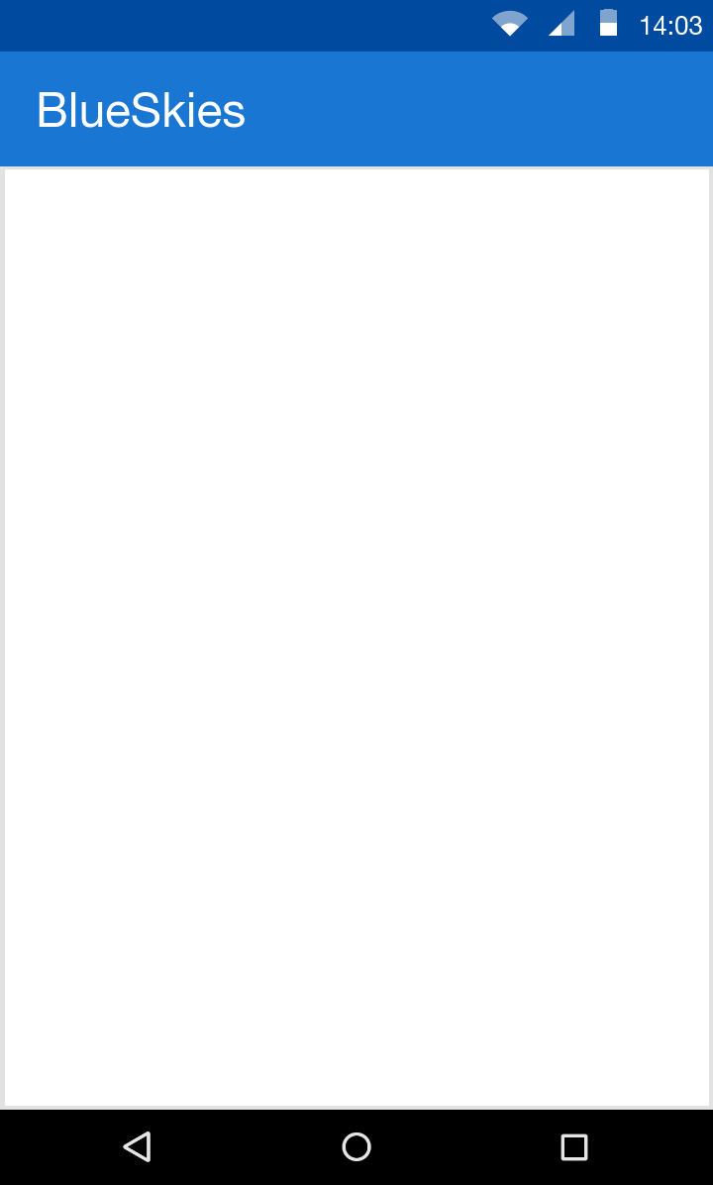

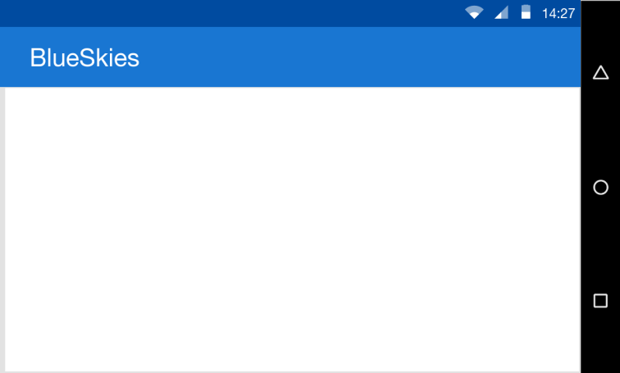
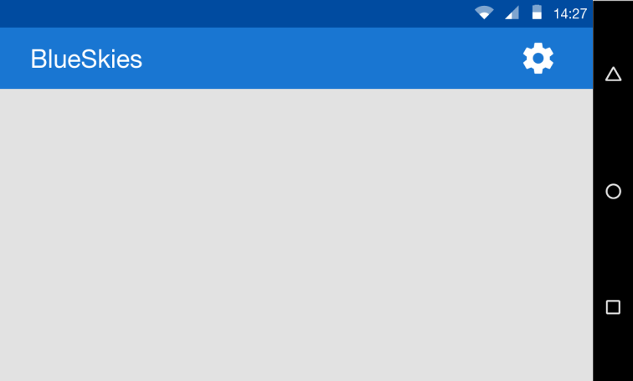

How Activity is like a Picture frame?
Defines the dimensions
Defines orientation, either portrait or landscape
Defines the decorations

Slide 12
Fragment https://developer.android.com/guide/components/fragments.html
View and Layout logic
Event handling (i.e. onClick())
Network request
Interacting with a persistence storage

Slide 13
Detail Level

Slide 14
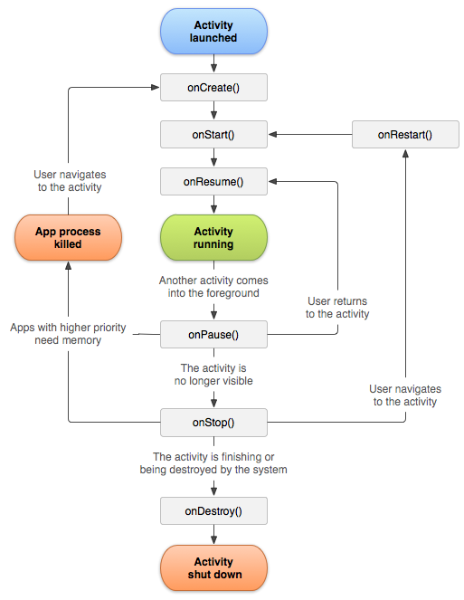

Slide 15
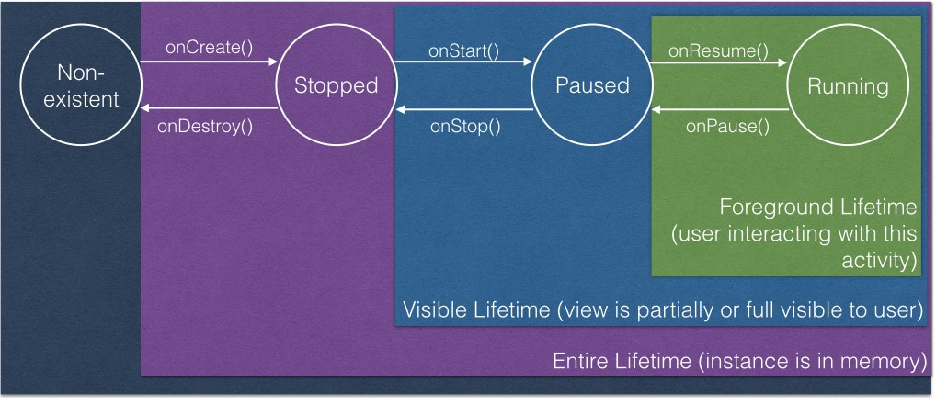
Activity Lifecycle
onCreate() started, but not visible

Slide 16
Activity Lifecycle
onStart() visible, but not ready for interaction

Slide 17
Activity Lifecycle
onResume() in the foreground,
ready for interaction

Slide 18
Activity Lifecycle
onPause() moving to the background,
stopping user interaction

Slide 19
Activity Lifecycle
onStop() moved to the background
and not visible

Slide 20
Activity Lifecycle
onDestroy() moved to the background
and not visible

Slide 21
Activity Lifecycle counterparts
OnCreate()
OnDestroy()
onStart()
onStop()
onResume()
onPause()

Slide 22
Activity Lifecycle
onRestart() activity is stoppd, then started again

Slide 23
Hitting back
onDestroy()

Slide 24
Home button
Stopped

Slide 25
SavedInstanceState
On Rotation
App is killed

Slide 26
Github

